Slide 1
Python

Slide 2

Python.org https://www.python.org/

Slide 3
> python -V
Python 3.14.0
> pip -V
pip 25.3 from C:\Python\Python314\Lib\site-packages\pip (python 3.14)

Slide 4
Python
Python is a high-level, general-purpose programming language; its design philosophy emphasizes code readability with use of significant indentation
Python is dynamically type-checked and garbage-collected; supports multiple programming paradigms, including structured (particulary proce - dural), object-oriented and functional programming
Guido van Rossum began working on Python in late 1980s Python 3.0, was major revision and not completely backward-compatible with earlier vers.
Python has gained widespread use in the machine learning community; it is widely taught as introductory programming language
since 2000, Python has consistently ranked in top ten of most popular programming languages in the Programming Community Index

Slide 5
pip
pip is a package manager (package management system) written in Python and is used to install and manage software packages
the Python Software Foundation recommends using pip to install Python applications and its dependencies during deployment
connects to an online software repository of public packages, named the Python Package Index (PyPI); can be configured to connect to other package repositories (local or remote), provided that they comply to Python Enhancement Proposal
most distributions of Python come with pip preinstalled, Python 3.4 and later include pip by default

Slide 7
Connect.py
import sqlite3
# Connect to a database (or create it if it doesn't exist)
conn = sqlite3.connect('example.db')
# Create a cursor object to execute SQL commands
cursor = conn.cursor()
# Don't forget to close the connection when you're done
conn.close()

Slide 8
python Connect.py
example.db SQLite DataBase is created in local folder

Slide 9
or can use a context manager:
with sqlite3.connect('example.db') as conn:
cursor = conn.cursor() # Perform database operations here
using a context manager ensures that connection is properly closed, even if an exception occurs

Slide 10
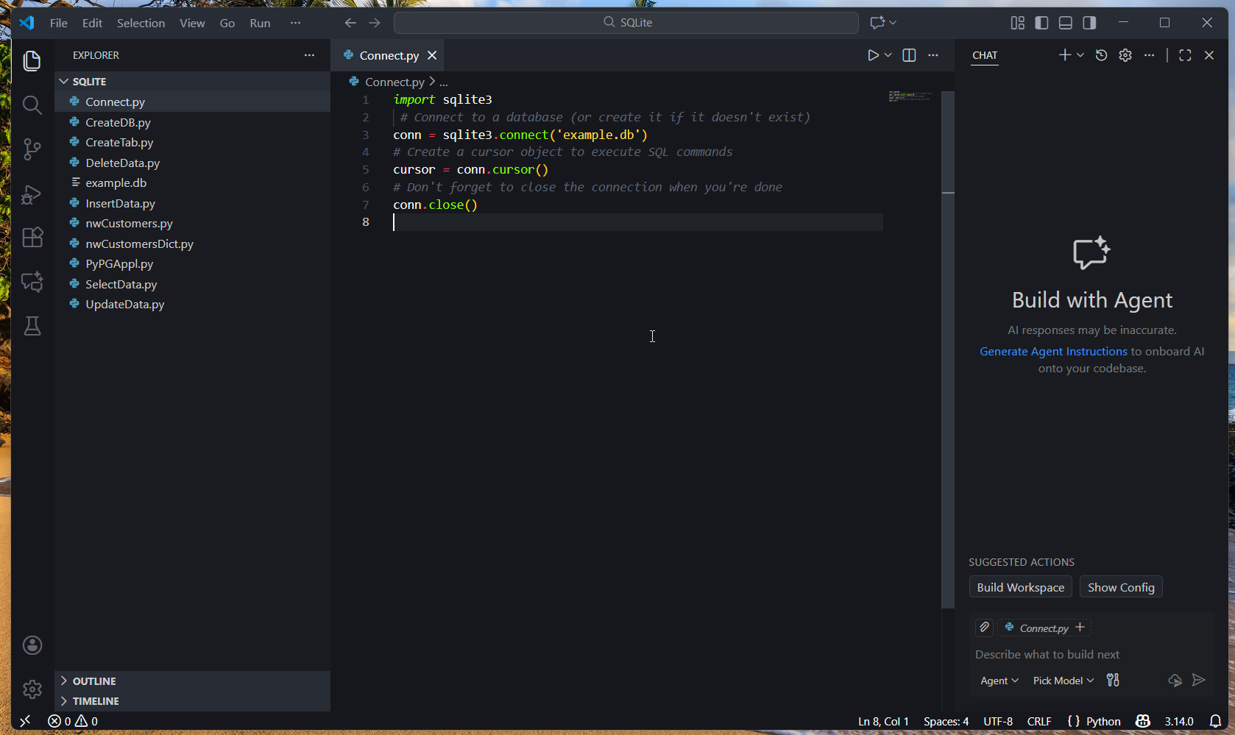

Slide 11
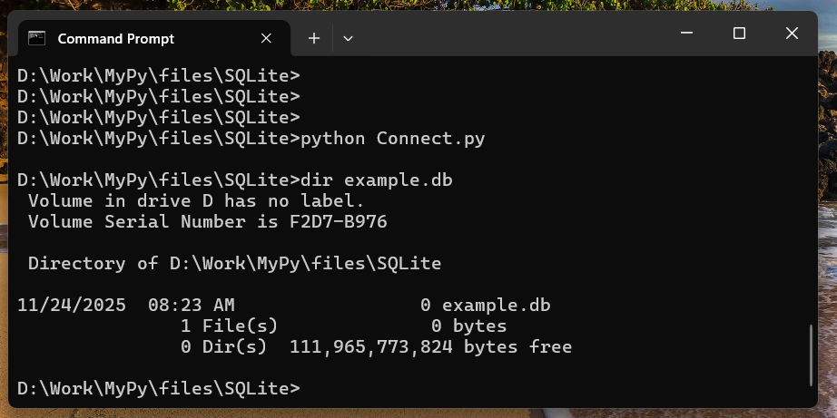

Slide 12
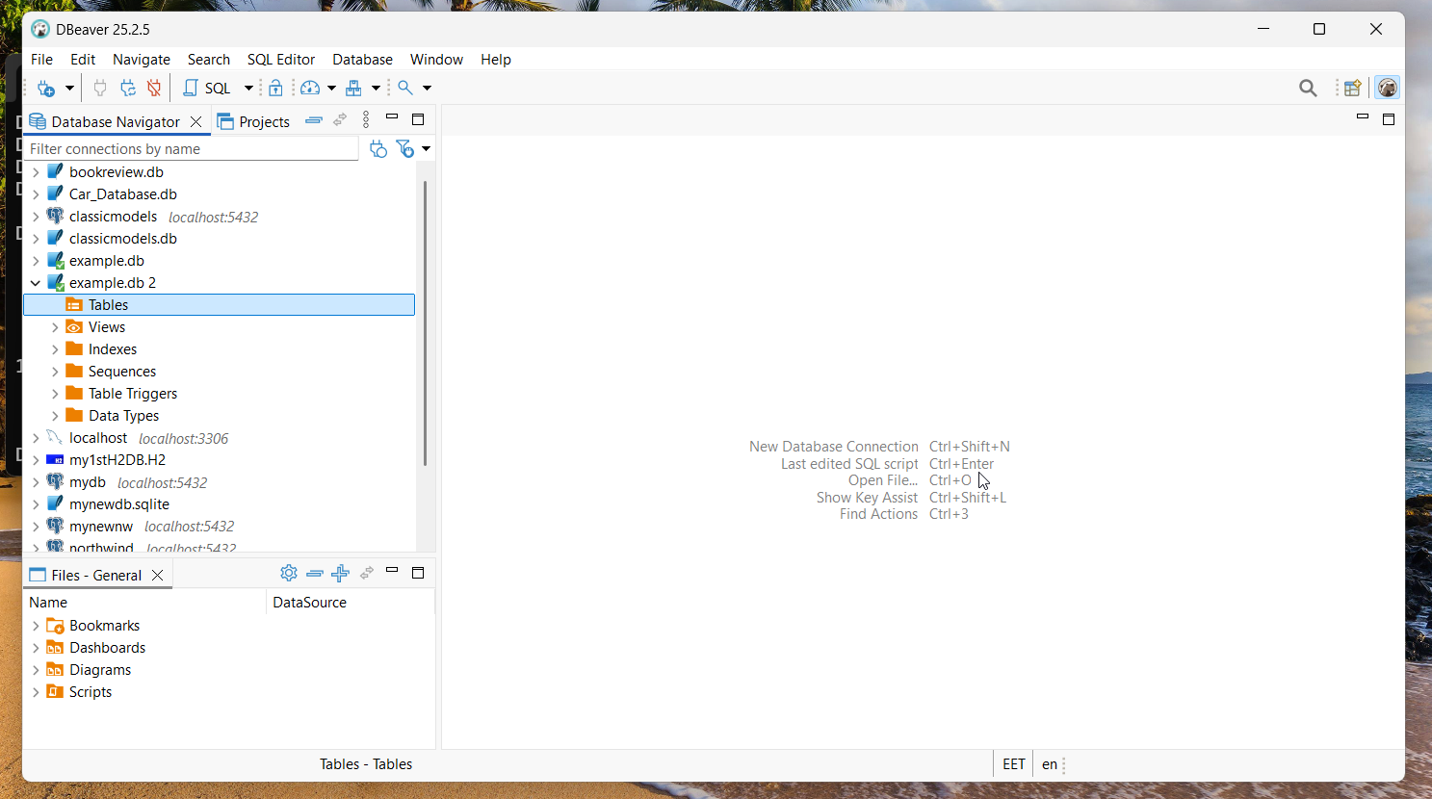

Slide 13
CreateTab.py
create table using python - execute the CREATE TABLE statement using the execute() method of the Cursor
> python CreateTab.py
Table created successfully........

Slide 14
CreateTab.py
import sqlite3
# Connect to a database (or create it if it doesn't exist)
with sqlite3.connect('example.db') as conn:
cursor = conn.cursor() # Perform database operations here
#Creating table as per requirement
sql = '''CREATE TABLE EMPLOYEE(
ID INTEGER PRIMARY KEY ,
FIRST_NAME TEXT NOT NULL,
LAST_NAME TEXT NOT NULL,
AGE INTEGER,

Slide 15
CreateTab.py
AGE INTEGER,
GENDER CHAR(1),
INCOME REAL,
UNIQUE ( FIRST_NAME, LAST_NAME ))'''
cursor.execute(sql)
print("Table created successfully........")

Slide 16
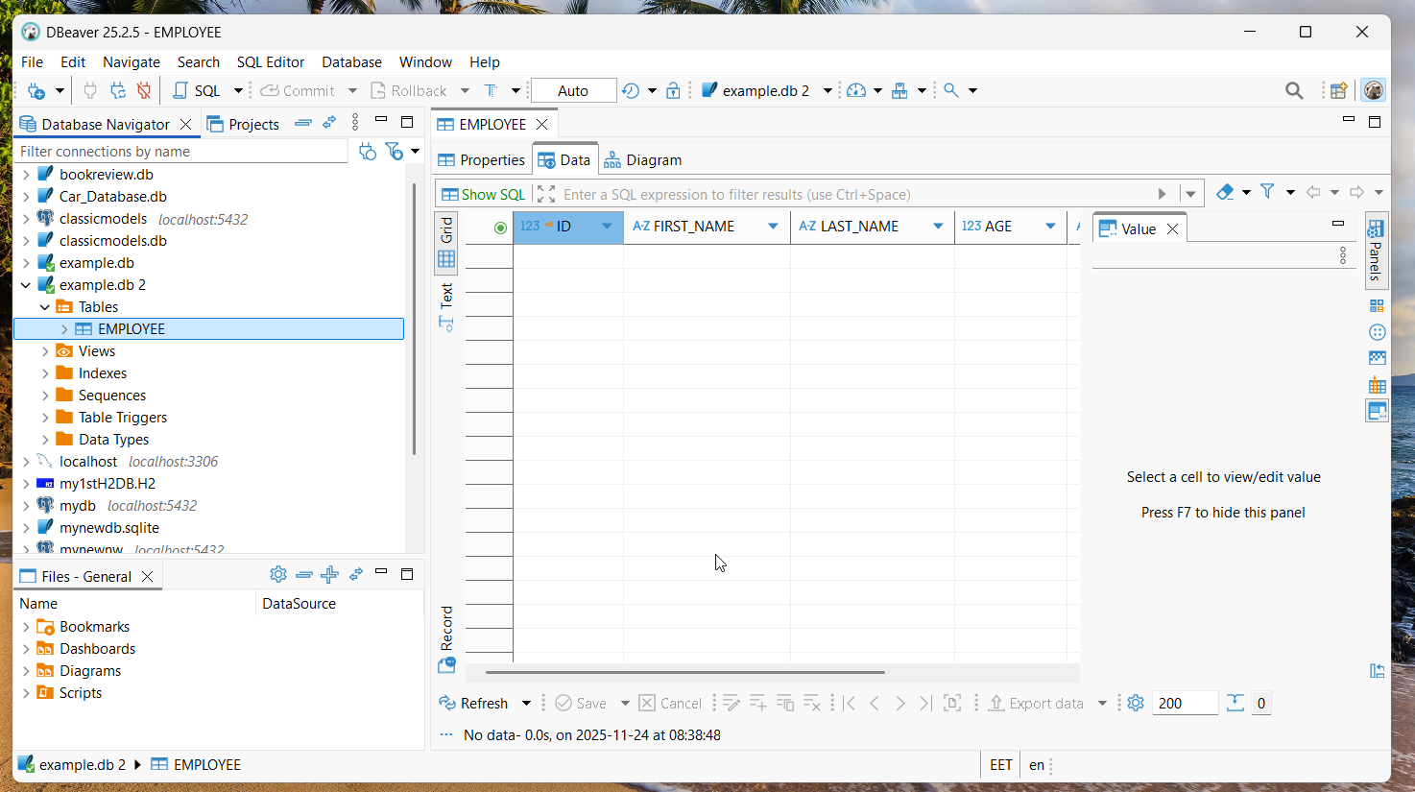

Slide 18
Create
InsertData.py
cursor class provides a method with name execute()
method accepts query as parameter and executes it
import sqlite3 package
create a connection object using connect() method
turn on auto-commit mode
cursor() method of Connection class of sqlite3 library returns cursor object; create cursor object using this method
execute INSERT statement(s) by passing it as parameter to execute() method

Slide 19
InsertData.py
import sqlite3
# Connect to a database (or create it if it doesn't exist)
with sqlite3.connect('example.db') as conn:
conn.autocommit = True
cursor = conn.cursor() # Perform database operations here
cursor.execute('''INSERT INTO EMPLOYEE(FIRST_NAME, LAST_NAME, AGE, GENDER, INCOME)
VALUES ('Daniela', 'CRUDU', 27, 'F', 9000)'‘’)
cursor.execute('''INSERT INTO EMPLOYEE(FIRST_NAME, LAST_NAME, AGE, GENDER, INCOME)
VALUES ('Nina', 'ILIESCU', 99, 'F', 5000)''')

Slide 20
InsertData.py
cursor.execute('''INSERT INTO EMPLOYEE(FIRST_NAME, LAST_NAME, AGE, GENDER, INCOME)
VALUES ('Emil', 'CONSTANTINESCU', 88, 'M', 6000)''')
cursor.execute('''INSERT INTO EMPLOYEE(FIRST_NAME, LAST_NAME, AGE, GENDER, INCOME)
VALUES ('Traian', 'BASESCU', 77, 'M', 7000)''')
cursor.execute('''INSERT INTO EMPLOYEE(FIRST_NAME, LAST_NAME, AGE, GENDER, INCOME)
VALUES ('Klaus Werner', 'JOHANNIS', 66, 'M', 8000)''')
cursor.execute('''INSERT INTO EMPLOYEE(FIRST_NAME, LAST_NAME, AGE, GENDER, INCOME)
VALUES ('Nicusor', 'DAN', 55, 'M', 9000)''')
print("Records inserted........")

Slide 21
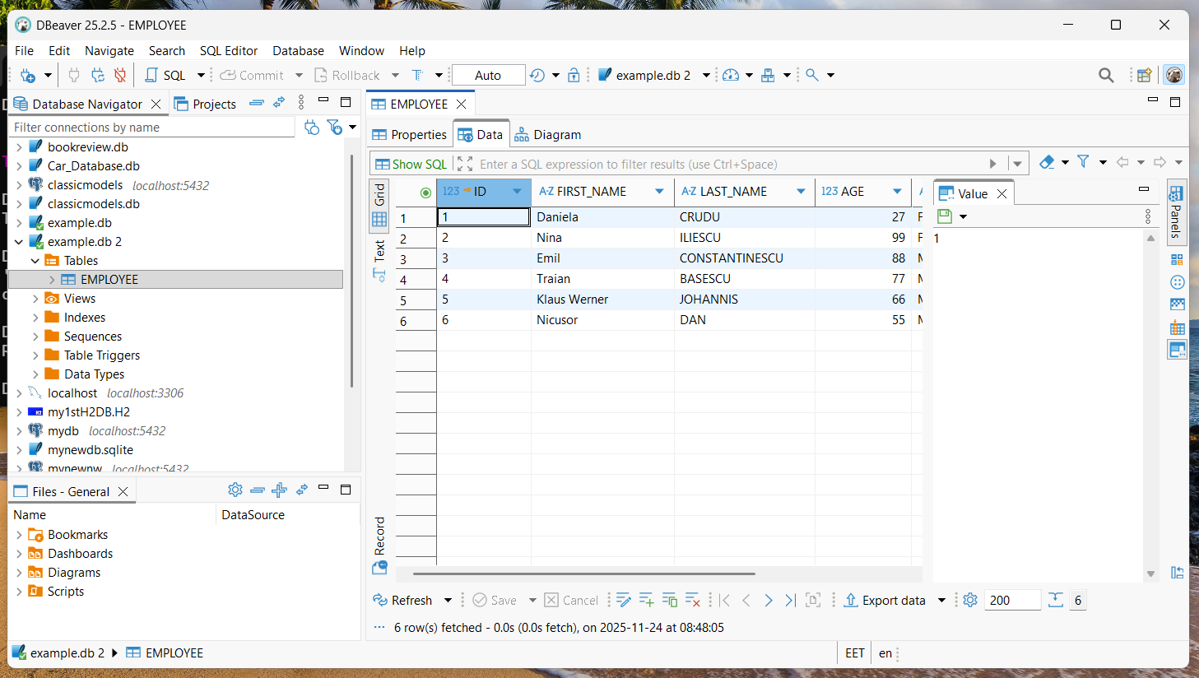

Slide 22
to insert multiple records efficiently, can use executemany()

Slide 23
InsertDataMany.py
import sqlite3
# Connect to a database (or create it if it doesn't exist)
employee_data = [
('Mirna', 'Burkin', 73, 'F', 4542.46),
('Sherman', 'Livezey', 76, 'M', 5228.15),
('Katusha', 'Van der Kruijs', 109, 'F', 4080.52),
('Barbie', 'Mahaddie', 73, 'F', 5073.8),
…

Slide 24
InsertDataMany.py
…
('Elvira', 'Pinwell', 37, 'F', 6045.1),
('Rodolphe', 'Scoyne', 52, 'M', 8238.47),
]
with sqlite3.connect('example.db') as conn:
# Perform database operations here
conn.autocommit = True
cursor = conn.cursor()
cursor.executemany('''

Slide 25
InsertDataMany.py
cursor.executemany('''
insert into EMPLOYEE (first_name, last_name, age, gender, income) values (?, ?, ?, ?, ?);
''', employee_data)
conn.commit()
print("Records inserted........")
#Commit your changes in the database
conn.commit()
#Closing the connection
conn.close()

Slide 26
Read
SelectData.py
retrieving data means to fetch some useful information from database
can fetch data using fetch() method provided by sqlite3
cursor class provides methods
  fetchall()
  fetchone()
  fetchmany()

Slide 27
cursor.fetchall() fetches all the rows of a query result; returns all rows as list of tuples; empty list is returned if there is no record to fetch; if execute this after retrieving some rows, it returns remaining ones
cursor.fetchone() method returns single record or None if no more rows are available
cursor.fetchmany(size) returns number of rows specified by size argument; when called repeatedly, this method fetches the next set of rows of query result and returns list of tuples; if no more rows are available, it returns an empty list

Slide 28
SelectData.py
import sqlite3
# Connect to a database (or create it if it doesn't exist)
with sqlite3.connect('example.db') as conn:
# Perform database operations here
conn.autocommit = True

Slide 29
SelectData.py
cursor = conn.cursor()
cursor.execute('''SELECT * from EMPLOYEE''')
result = cursor.fetchone()
print(result)
result = cursor.fetchone()
print(result)
result = cursor.fetchmany(101)
print(result)
result = cursor.fetchall()
print(result)
cursor.execute('''SELECT * from EMPLOYEE WHERE GENDER = 'M' ''')
result = cursor.fetchall()
print(result)

Slide 30
SelectData.py
#Commit your changes in the database
conn.commit()
#Closing the connection
conn.close()

Slide 31
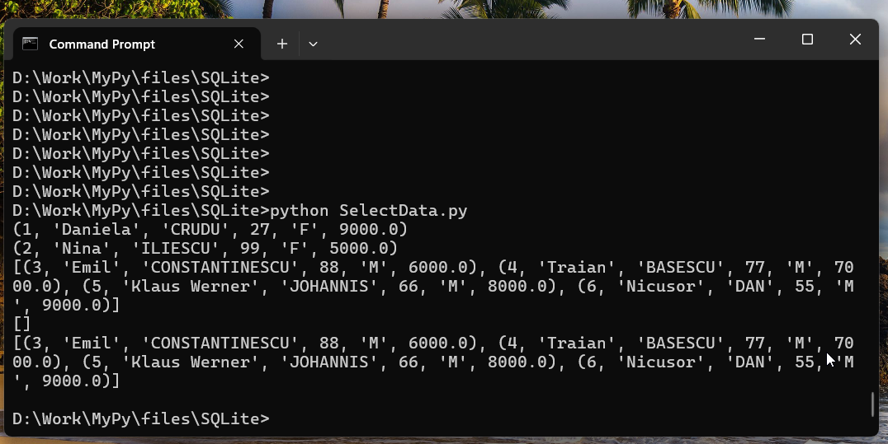

Slide 32
cursor.execute('''SELECT * from EMPLOYEE''')
result = cursor.fetchone()
print(result)
(1, 'Daniela', 'CRUDU', 27, 'F', 9000.0)
result = cursor.fetchone()
print(result)
(2, 'Nina', 'ILIESCU', 99, 'F', 5000.0)
result = cursor.fetchmany(101)
print(result)
[(3, 'Emil', 'CONSTANTINESCU', 88, 'M', 6000.0), (4, 'Traian', 'BASESCU', 77, 'M', 7000.0), (5, 'Klaus Werner', 'JOHANNIS', 66, 'M', 8000.0), (6, 'Nicusor', 'DAN', 55, 'M', 9000.0)]

Slide 33
result = cursor.fetchall()
print(result)
[]
cursor.execute('''SELECT * from EMPLOYEE WHERE GENDER = 'M' ''')
result = cursor.fetchall()
print(result)
[(3, 'Emil', 'CONSTANTINESCU', 88, 'M', 6000.0), (4, 'Traian', 'BASESCU', 77, 'M', 7000.0), (5, 'Klaus Werner', 'JOHANNIS', 66, 'M', 8000.0), (6, 'Nicusor', 'DAN', 55, 'M', 9000.0)]

Slide 34
SelectDataT.py
with sqlite3.connect('example.db') as conn:
# Perform database operations here
conn.autocommit = True
cursor = conn.cursor()
cursor.execute('''SELECT * from EMPLOYEE''')
result = cursor.fetchall()
for row in result:
print(f"{row[1]} {row[2]} is {row[3]} years old")

Slide 35
Daniela CRUDU is 27 years old
Nina ILIESCU is 99 years old
Emil CONSTANTINESCU is 88 years old
Traian BASESCU is 77 years old
Klaus Werner JOHANNIS is 66 years old
Nicusor DAN is 55 years old

Slide 36
by default, cursor returns results as tuples
can access columns by index, but this can be error-prone
to make code more readable, you can use sqlite3.Row row factory:

Slide 37
SelectDataD.py
with sqlite3.connect('example.db') as conn:
# Perform database operations here
conn.autocommit = True
conn.row_factory = sqlite3.Row
cursor = conn.cursor()
cursor.execute('''SELECT * from EMPLOYEE''')
result = cursor.fetchall()
for row in result:
print(f"{row['FIRST_NAME']} {row['LAST_NAME']} is {row['AGE']} years old")

Slide 38
Update UpdateData.py
import sqlite3
# Connect to a database (or create it if it doesn't exist)
with sqlite3.connect('example.db') as conn:
# Perform database operations here
conn.autocommit = True
cursor = conn.cursor()
#Fetching all the rows before the update
print("Contents of the Employee table - Before")
sql = '''SELECT * from EMPLOYEE'''
cursor.execute(sql)
print(cursor.fetchall())

Slide 39
UpdateData.py
#Updating the records
sql = "UPDATE EMPLOYEE SET AGE = AGE + 1 WHERE GENDER = 'M'"
cursor.execute(sql)
print("Table updated...... ")

Slide 40
#Fetching all the rows after the update
print("Contents of the Employee table - After update operation: ")
sql = '''SELECT * from EMPLOYEE'''
cursor.execute(sql)
print(cursor.fetchall())
#Commit your changes in the database
conn.commit()
#Closing the connection
conn.close()

Slide 41
Update
UpdateData.py
> python UpdateData.py
Contents of the Employee table:
[(1, 'Daniela', 'CRUDU', 27, 'F', 9000.0), (2, 'Nina', 'ILIESCU', 99, 'F', 5000.0), (3, 'Emil', 'CONSTANTINESCU', 88, 'M', 6000.0), (4, 'Traian', 'BASESCU', 77, 'M', 7000.0), (5, 'Klaus Werner', 'JOHANNIS', 66, 'M', 8000.0), (6, 'Nicusor', 'DAN', 55, 'M', 9000.0)]
Table updated......
Contents of the Employee table after the update operation:
[(1, 'Daniela', 'CRUDU', 27, 'F', 9000.0), (2, 'Nina', 'ILIESCU', 99, 'F', 5000.0), (3, 'Emil', 'CONSTANTINESCU', 89, 'M', 6000.0), (4, 'Traian', 'BASESCU', 78, 'M', 7000.0), (5, 'Klaus Werner', 'JOHANNIS', 67, 'M', 8000.0), (6, 'Nicusor', 'DAN', 56, 'M', 9000.0)]

Slide 42
Delete
DeleteData.py

Slide 43
Parameterized Queries
and security avoiding SQL injection with parameterized queries
SQL injection is a serious security vulnerability that can occur when user input is directly incorporated into SQL queries without proper sanitization
can allow malicious users to manipulate or access unauthorized data
simple and effective way to prevent SQL injection through parameterized queries - use placeholders in SQL statement for values, and these values are provided separately; approach ensures that input is properly escaped and treated as data, not as part of SQL command

Slide 44
unsafe method (vulnerable to SQL injection):
user_input = "O'Toole"
# This could be malicious input
cursor.execute(f"SELECT * FROM users WHERE name = '{user_input}’”)
if malicious user provides input like "O'Toole' OR '1'='1" , resulting query would be: SELECT * FROM users WHERE name = 'O'Toole' OR '1'='1’ this would return all users, potentially exposing sensitive data

Slide 45
Safe method (using parameterized query):
user_input = "O'Toole"
cursor.execute("SELECT * FROM users WHERE name = ?", (user_input,))
in this case, even if user input contains quotes or other SQL special characters, they will be properly escaped and treated as literal data

Slide 46
two styles of placeholders:
question mark style: uses ? as a placeholder
  cursor.execute("INSERT INTO users (name, age) VALUES (?, ?)", ("Alice", 30))
named parameter style: uses :name or :1 style named placeholders.
  cursor.execute("INSERT INTO users (name, age) VALUES (:name, :age)", {"name": "Bob", "age": 25})

Slide 47
DeleteData.py
import sqlite3
# Connect to a database (or create it if it doesn't exist)
# input
print(f"Enter Age limit:")
inputAge = input()
print(f"Enter Income limit:")
inputIncome = input()

Slide 48
DeleteData.py
with sqlite3.connect('example.db') as conn:
# Perform database operations here
conn.autocommit = True
cursor = conn.cursor()
#Fetching all the rows before the update
print("Contents of the Employee table - Before")
sql = '''SELECT * from EMPLOYEE'''
cursor.execute(sql)
print(cursor.fetchall())

Slide 49
DeleteData.py
#Deleting the records
sql = '''DELETE FROM EMPLOYEE WHERE AGE > ? AND INCOME < ?'''
cursor.execute(sql,(inputAge, inputIncome,))
print("Table updated...... ")

Slide 50
DeleteData.py
#Fetching all the rows after the update
print("Contents of the Employee table - After the update operation: ")
sql = '''SELECT * from EMPLOYEE'''
cursor.execute(sql)
print(cursor.fetchall())
#Commit your changes in the database
conn.commit()
#Closing the connection
conn.close()

Slide 51
> python DeleteData.py
Enter Age limit:
100
Enter Income limit:
23456
Contents of the Employee table - Before
[(1, 'Daniela', 'CRUDU', 27, 'F', 9000.0), (2, 'Nina', 'ILIESCU', 99, 'F', 5000.0), (3, 'Emil', 'CONSTANTINESCU', 89, 'M', 6000.0), (4, 'Traian', 'BASESCU', 78, 'M', 7000.0), (5, 'Klaus Werner', 'JOHANNIS', 67, 'M', 8000.0), (6, 'Nicusor', 'DAN', 56, 'M', 9000.0), (7, 'Mirna', 'Burkin', 73,
…
Table updated......
Contents of the Employee table - After the update operation:

